Slide 1
Big Data Technology BookReviewRatings
Author: Dora Khiev ID: 985520
Professor: Mrudula Mukadam

Slide 2
About BookReviewRatings
A small project to demonstrate the knowledge of Big Data Technologies and how to use each tools as a fundamental level.
The project is used to give a brief overview of report for user ratings over a large collections of books.
This project will use some several tools such as
Spark Data Streaming
Flume
HDFS
Hive

Slide 3
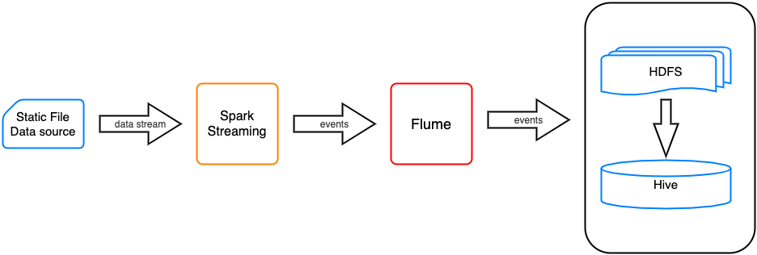
Project Overall Architecture

Slide 4
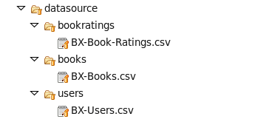
Data Source (Static files)
Data source tree structure:
Source download link: https://www.kaggle.com/ruchi798/bookcrossing-dataset
These files are located in /BookReviewRate/datasource inside the project.

Slide 5
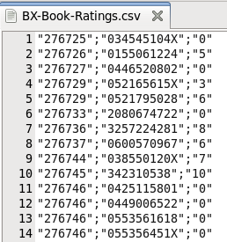
Data Source (Static files) - Cont.
Sample data for BX-Book-Ratings.csv
Header is divided into three fields:
Book ID.
ISBN number.
Rating.

Slide 6
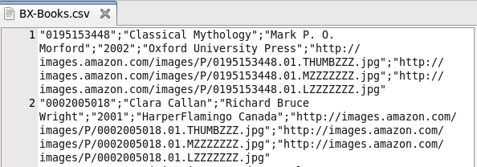
Data Source (Static files) - Cont.
Sample data for BX-Books.csv
Header is divided into 8 fields:
ISBN
Book Title
Book Author
Year of Publication
Publisher
Image Url S
Image Url M
Image Url L

Slide 7
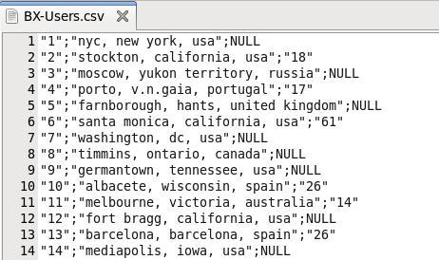
Data Source (Static files) - Cont.
Sample data for BX-Users.csv
Header is divided into 3 fields:
User ID
Location
Age

Slide 8
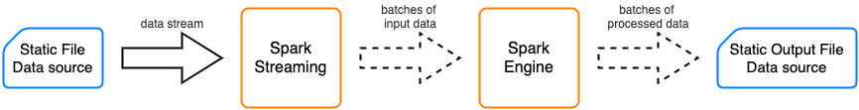
Spark Streaming

Slide 9
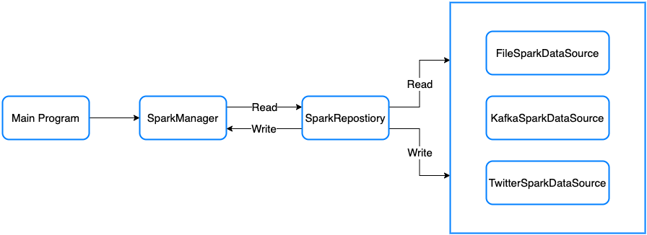
Spark Streaming - Cont.
Spark Streaming Repository Pattern

Slide 10
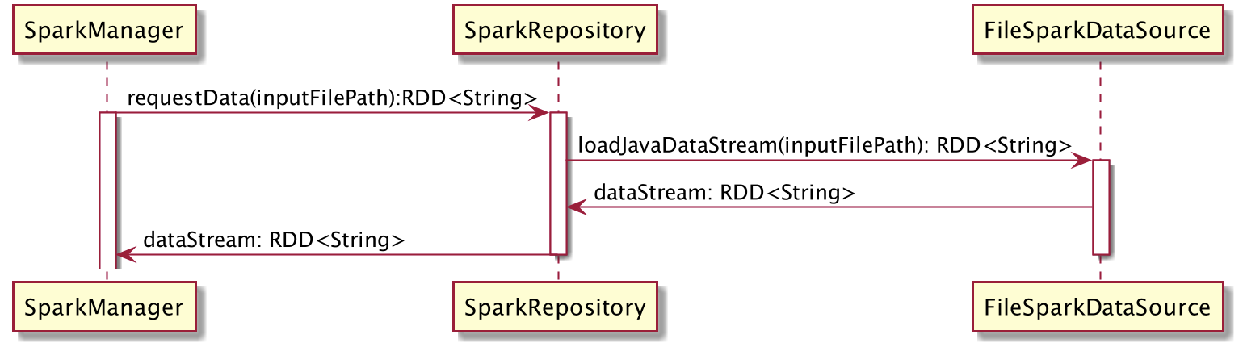
Spark Streaming - Cont.
Read File Sequence Diagram for Spark Streaming Repository

Slide 11
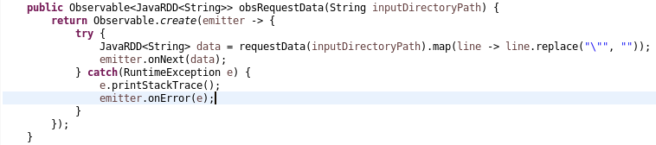
Spark Streaming - Cont.
SparkRepository.java
Read data stream from inputDirectoryPath as RDD<String>

Slide 12
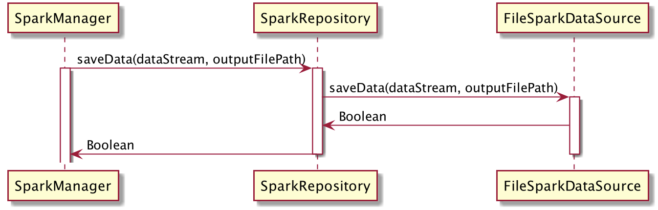
Spark Streaming - Cont.
Save File Sequence Diagram for Spark Streaming Repository

Slide 13
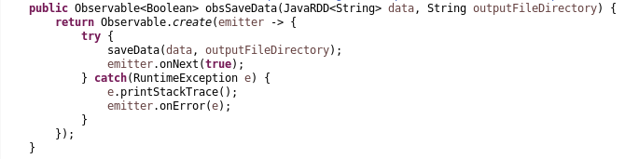
Spark Streaming - Cont.
SparkRepository.java
Save data stream into outputFileDirectory as RDD<String>

Slide 14
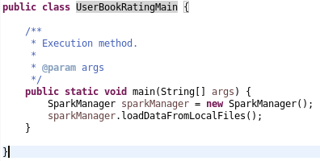
Spark Streaming - Cont.
Finally we can execute Spark streaming process going to UserBookRatingMain.java

Slide 15
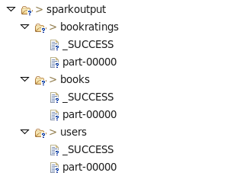
Spark Streaming - Cont.
Output data source tree structure:

Slide 16
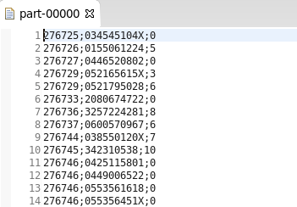
Spark Streaming - Cont.
Output file for book ratings (part-00000).

Slide 17
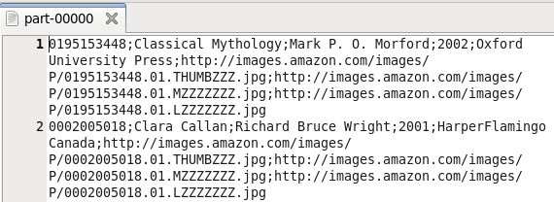
Spark Streaming - Cont.
Output file for books (part-00000).

Slide 18
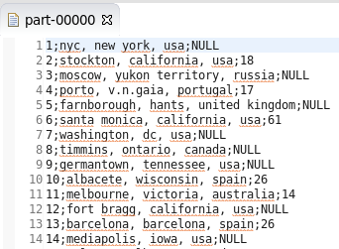
Spark Streaming - Cont.
Output file for users (part-00000).

Slide 19
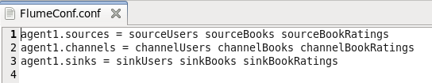
Flume
Imports output files into HDFS under HDFS path “hdfs://localhost/user/cloudera/userbookrating/”.
Flume configuration file is named as FlumeConf.conf
Since there are three output files source.
FlumeConf has also three different Sources, Channels, and Sinks.
Agent name is agent1.

Slide 20
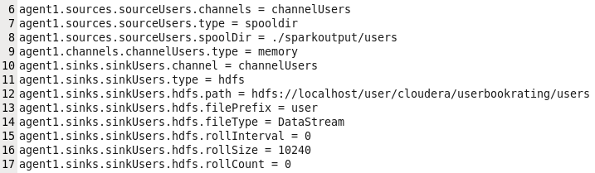
Flume - Cont.
Here is Flume configuration for users.

Slide 21
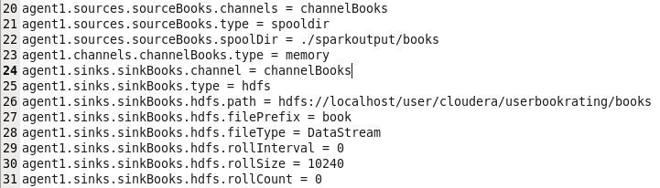
Flume - Cont.
Here is Flume configuration for books.

Slide 22
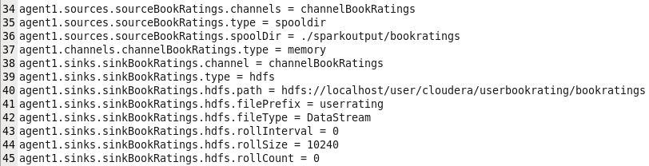
Flume - Cont.
Here is Flume configuration for bookratings.

Slide 23
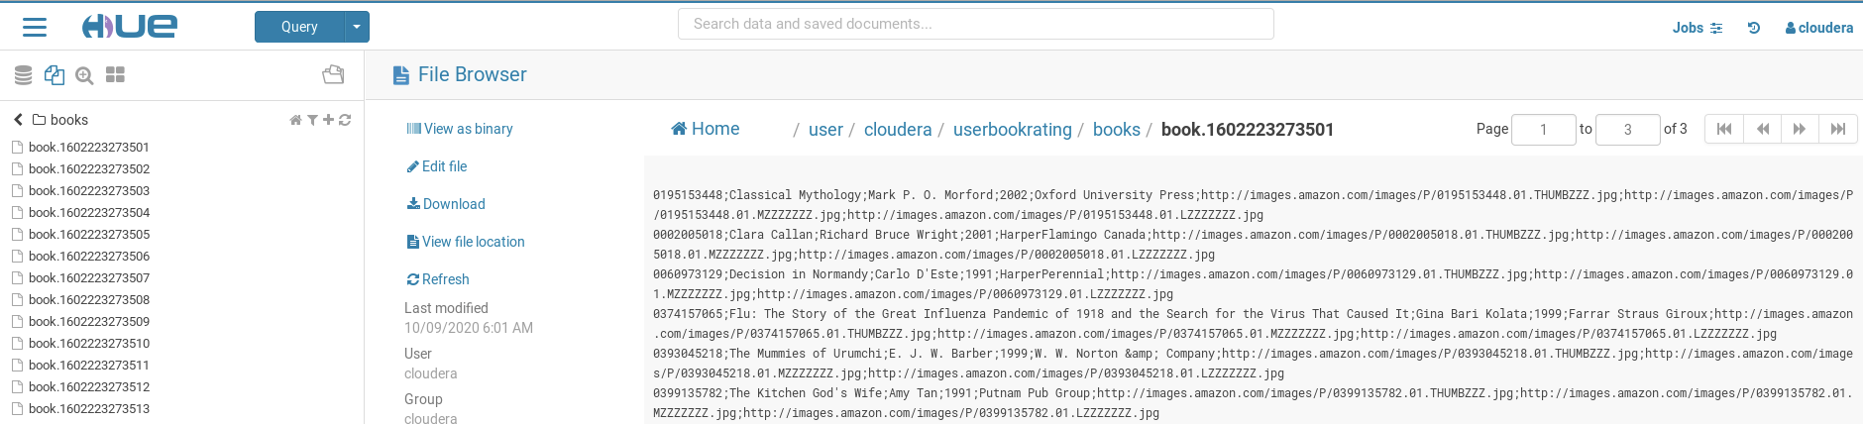
Flume - Cont.
Output files in HDFS for books

Slide 24
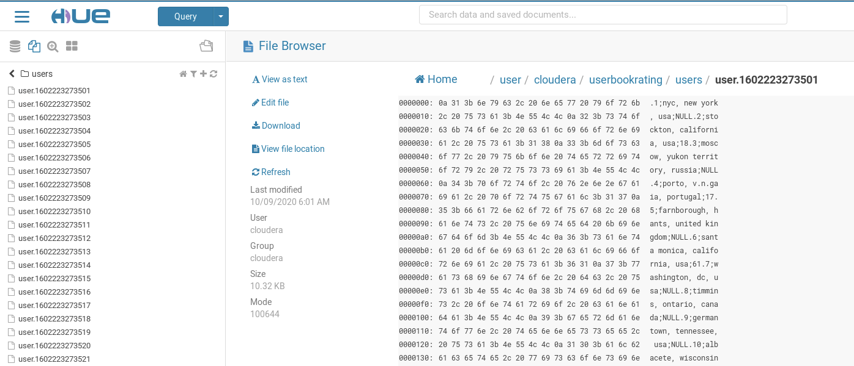
Flume - Cont.
Output files in HDFS for users

Slide 25
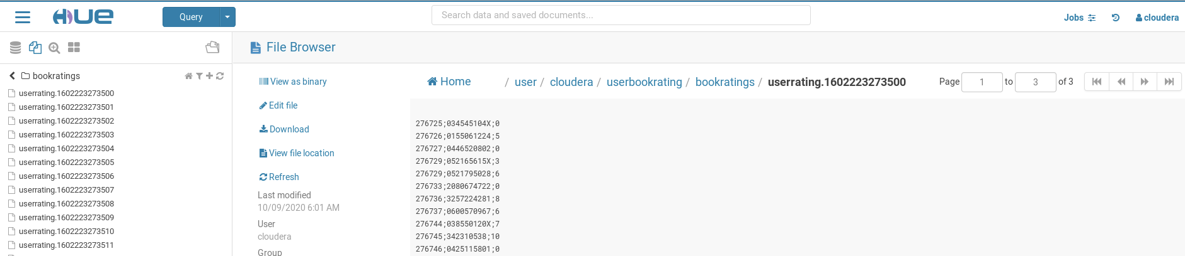
Flume - Cont.
Output files in HDFS for bookratings

Slide 26
Hive
Purposes
Builds logical database on top of HDFS.
Provides SQL query and data analysis.
Provides data to generate report.

Slide 27
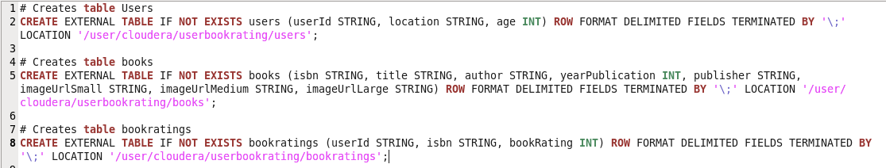
Hive - Cont.
Create tables command.
These commands are located in “BookReviewRate/shellscript/HiveCommand”

Slide 28
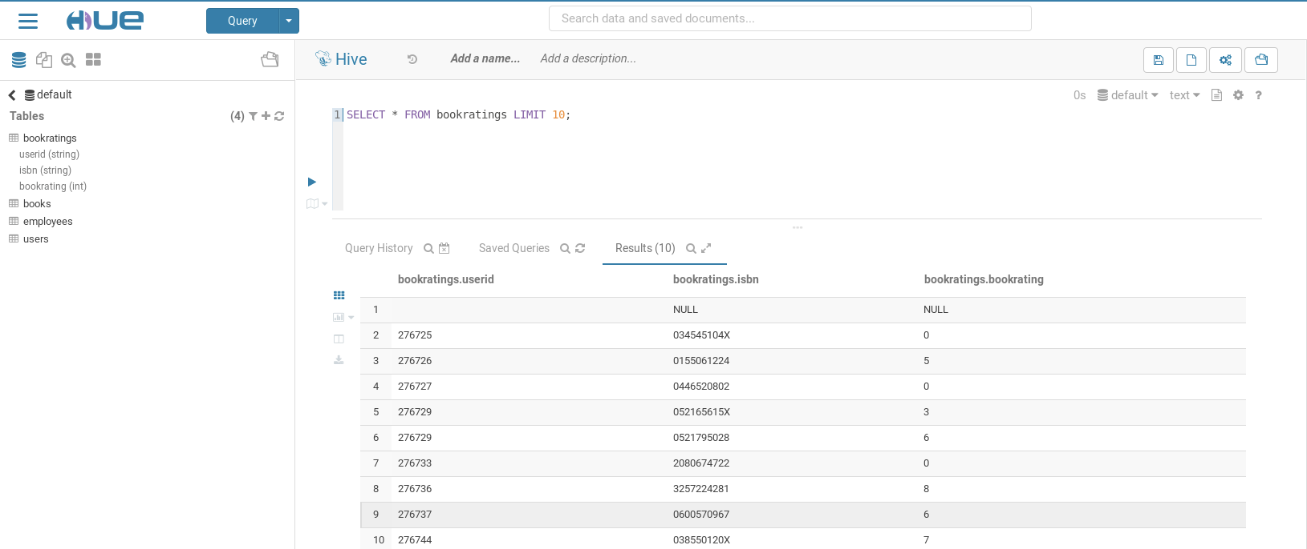
Hive - Cont.
Output data for table bookratings.

Slide 29
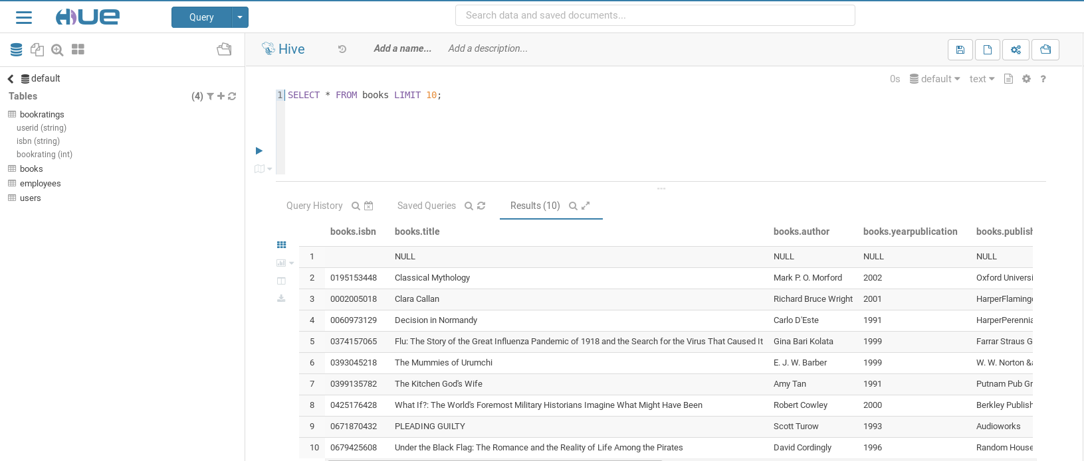
Hive - Cont.
Output data for table books.

Slide 30
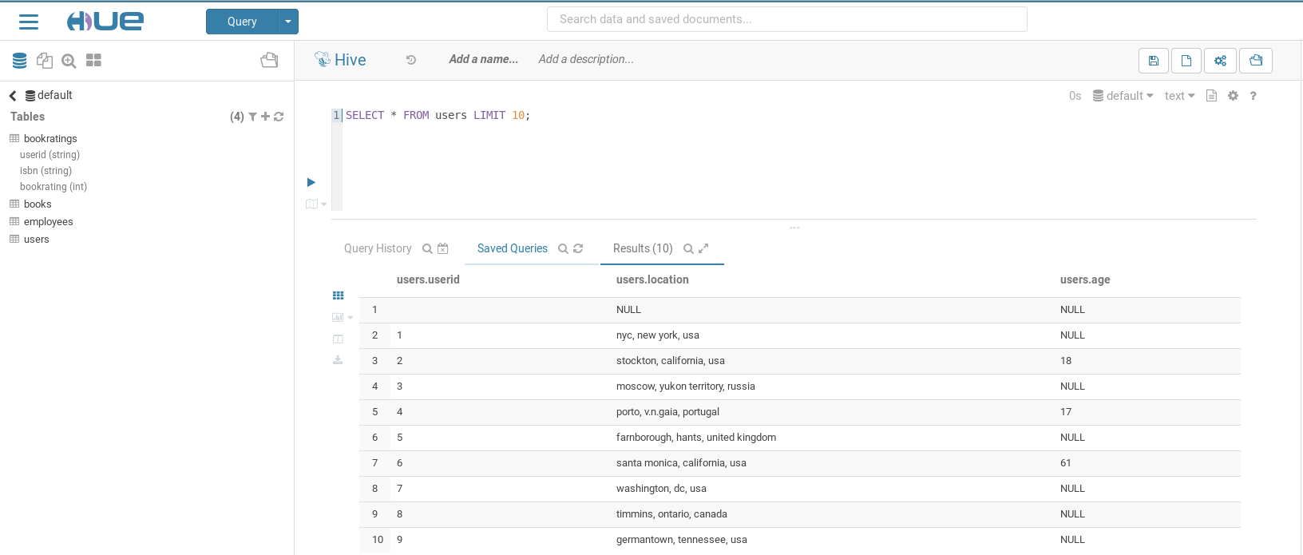
Hive - Cont.
Output data for table users.

Slide 31
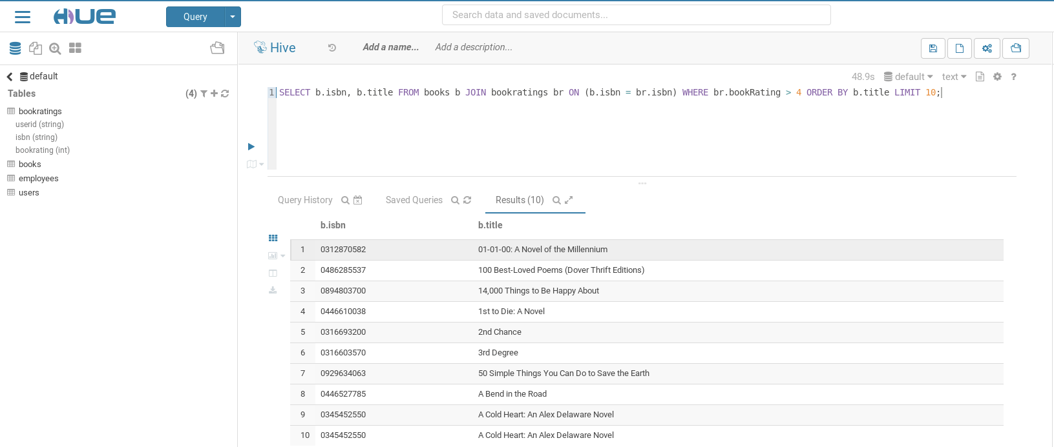
Hive - Cont.
Sample query to retrieve first 10 books that have rating > 4.

Slide 32
Apache Kafka
It is distributed message system between publisher and subscriber.
Handles high volume of data of message between publishers and subscribers.
Can be used with offline and online message consumption.

Slide 33
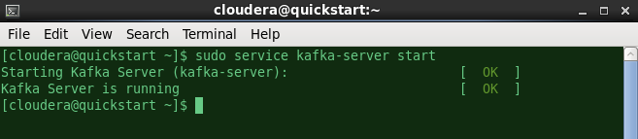
Apache Kafka - Commands
Start Kafka Service:
> sudo service kafka-server start

Slide 34
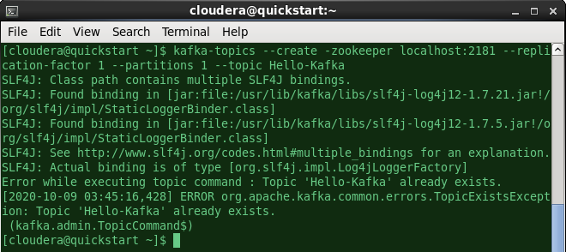
Apache Kafka - Commands - Cont.
Start create topic:
> kafka-topics --create -zookeeper localhost:2181 --replication-factor 1 --partitions 1 --topic Hello-Kafka

Slide 35
Apache Kafka - Commands - Cont.
Start producer for topic Hello-Kafka:
> kafka-console-producer --broker-list localhost:9092 --topic Hello-Kafka
Start consumer for topic Hello-Kafka:
> kafka-console-consumer --zookeeper localhost:2181 --topic Hello-Kafka --from-beginning

Slide 36
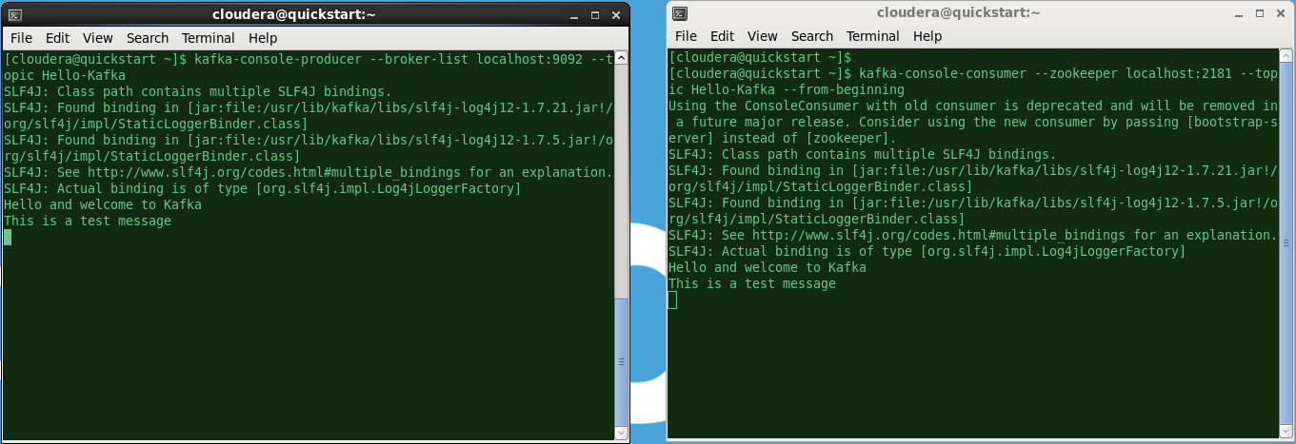
Apache Kafka - Commands - Cont.
Screenshots between Producer and Consumer

Slide 37
Demonstration

Slide 38
Thank You!

